Slide 1

K Nearest Neighbor (KNN)
Aksadur Rahman
aksadur@yahoo.com

Slide 2
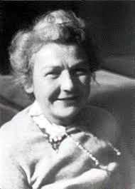
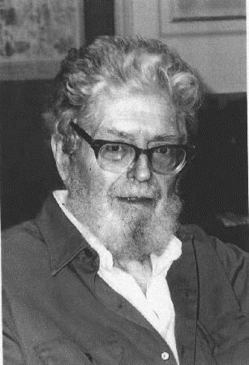
K Nearest Neighbor (KNN) Classifier
Evelyn Fix
Joseph Hodges

Slide 3
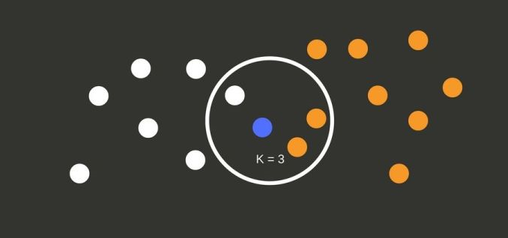
K Nearest Neighbor (KNN) Classifier
The k-nearest neighbors (KNN) algorithm is a simple, supervised machine learning algorithm that can be used to solve both classification and regression problems. It's easy to implement and understand

Slide 4
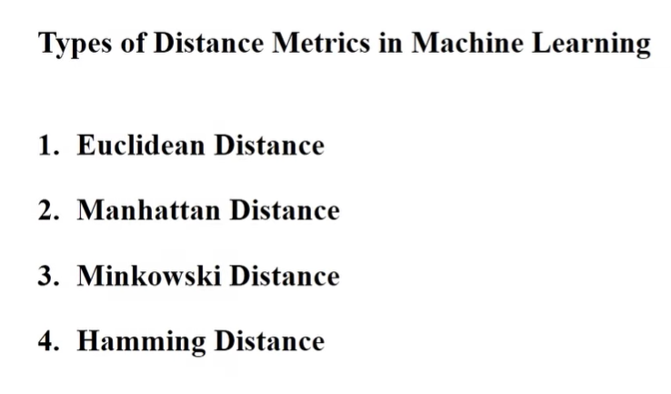
K Nearest Neighbor (KNN) Classifier
Problem-1
Training Data
Value-1 | Value-2 | Value-3 | Class
5 | 3 | 1 | A
2 | 4 | 2 | B
1 | 2 | 3 | B
4 | 3 | 2 | A
3 | 3 | 2 | A
1 | 3 | 2 | A
0 | 1 | 2 | B
Classify data pattern
using K-Nearest neighbor classifier, k=3
2 | 1 | 3 | ?

Slide 5
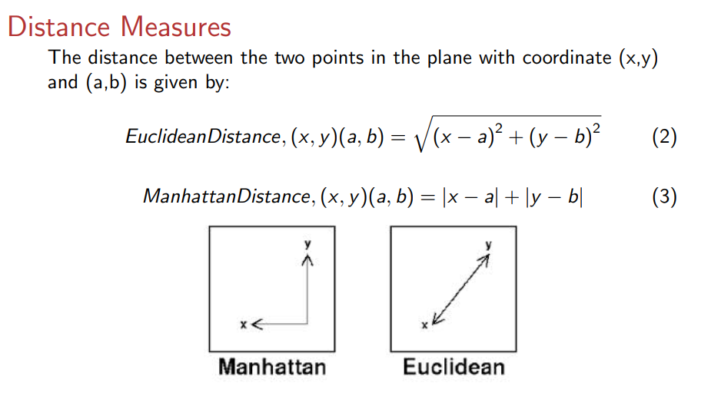
K Nearest Neighbor (KNN) Classifier

Slide 6
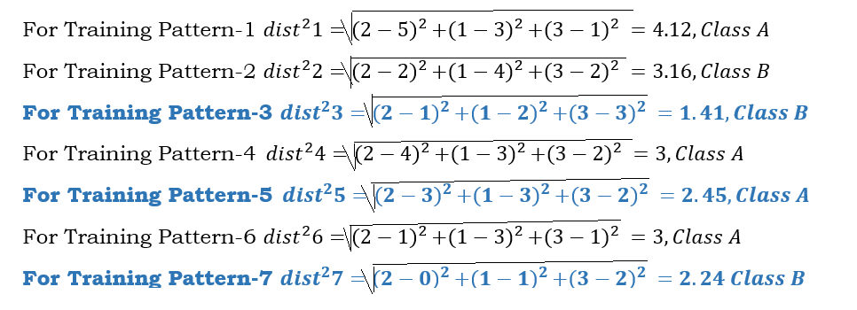
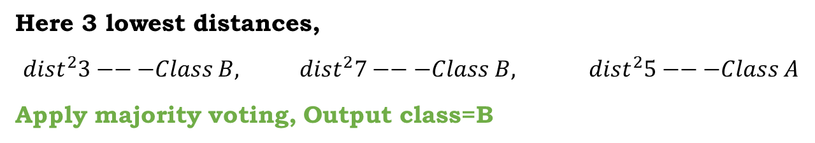
K Nearest Neighbor (KNN) Classifier
2 | 1 | 3 | ?
Answer:
Here 3 lowest distances,
${dist}^{2}3−−−Class B, {dist}^{2}7−−−Class B, { dist}^{2}5−−−Class A$
Apply majority voting, Output class=B

Slide 7
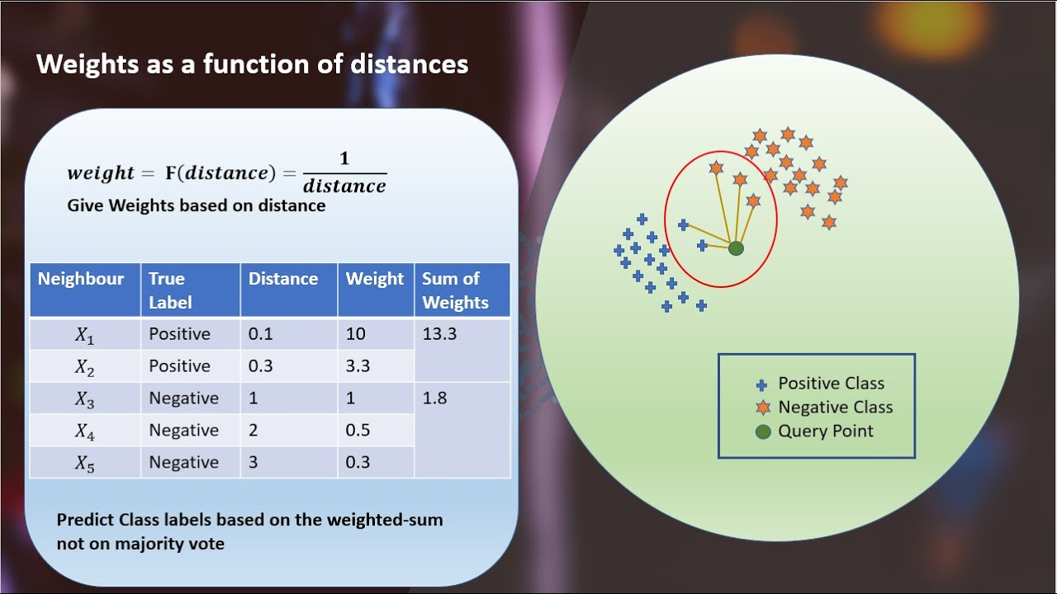
K Nearest Neighbor (KNN) Classifier
Weighted k-Nearest Neighbors (k-NN)

